Slide 1
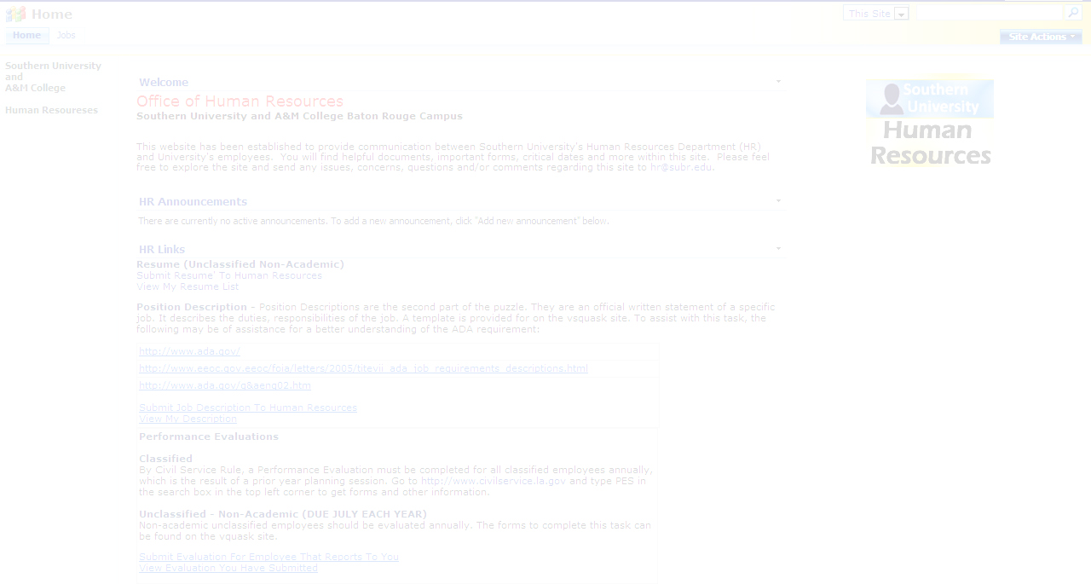
SUBMITTING FORMS VIA THE
VSQUASK WEBSITE
Designed By: Kadrica Tillotson

Slide 2
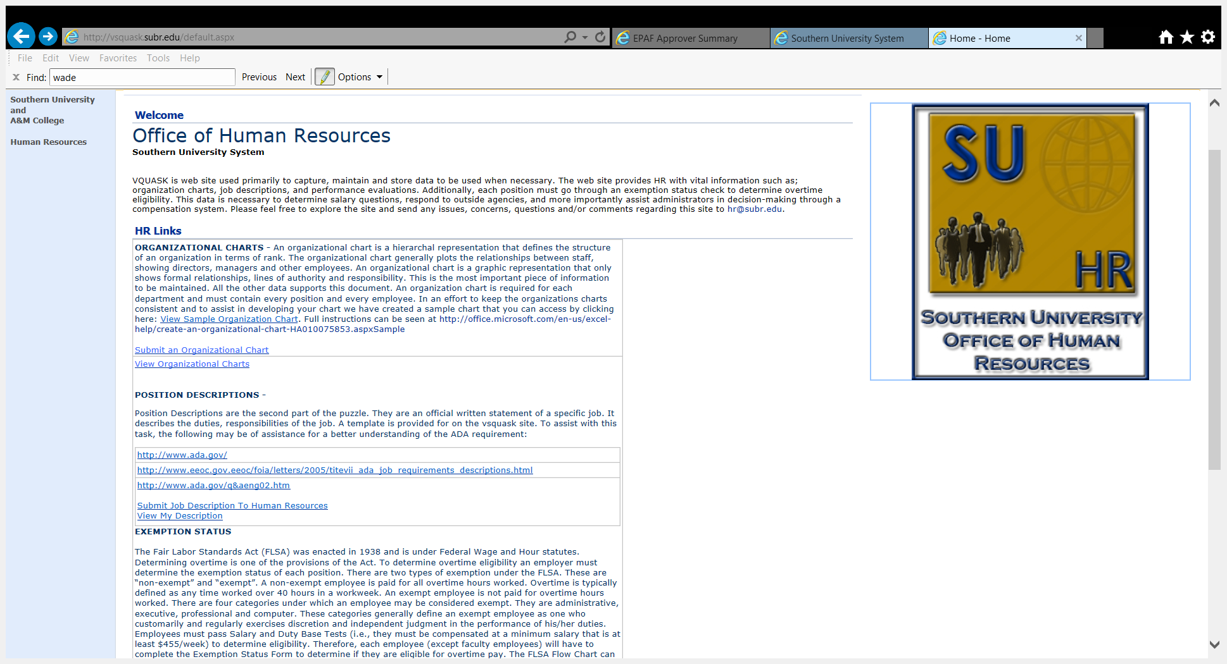
SUBMITTING AN ORGANIZATIONAL CHART
CLICK HERE
If you need assistance on how to create an organizational chart please click on the above link: View Sample Organization Chart.

Slide 3
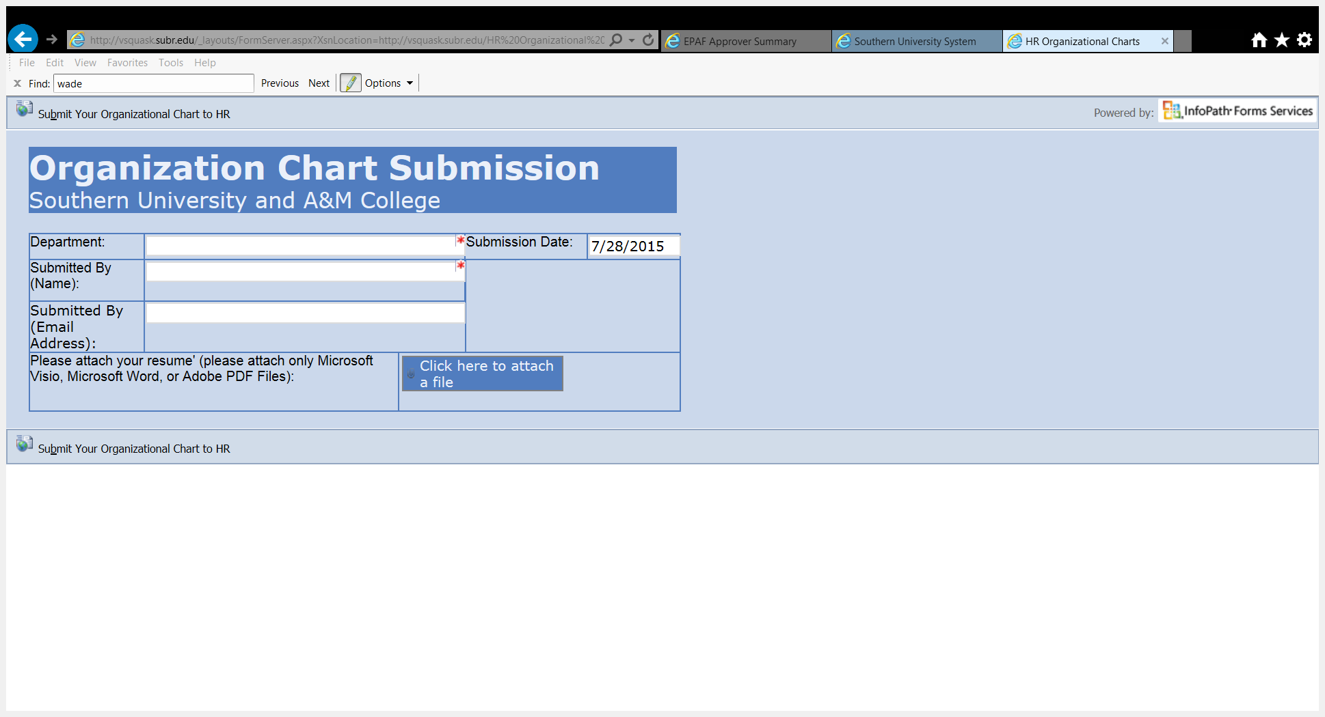
SUBMITTING AN ORGANIZATIONAL CHART (cont’d)
Required fields are indicated with a red star “*”
CLICK HERE TO ATTACH YOUR ORG CHART

Slide 4
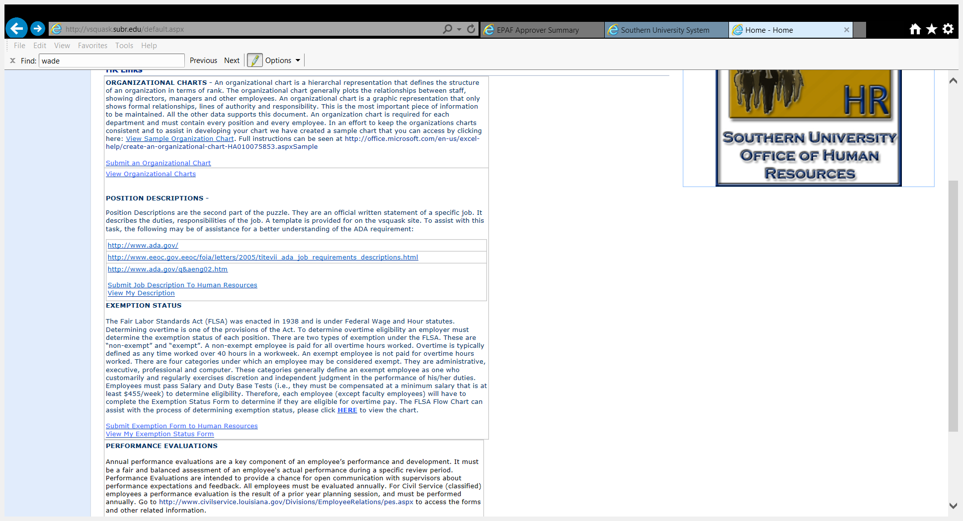
SUBMITTING A POSITION DESCRIPTION
CLICK HERE

Slide 5
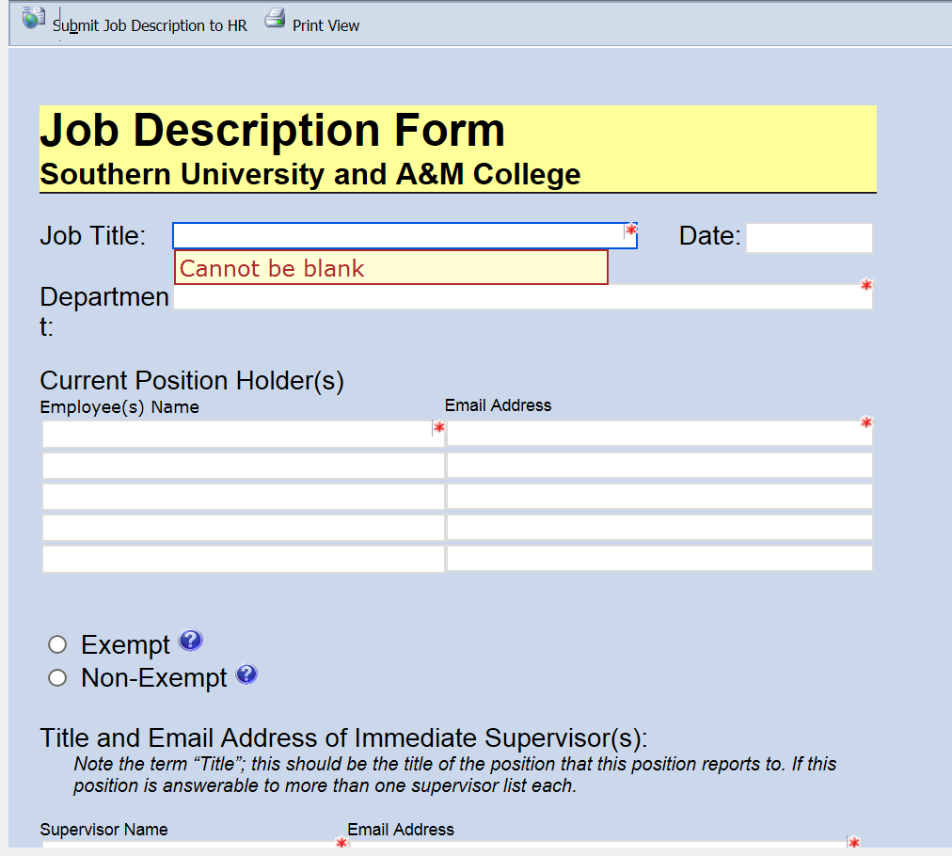
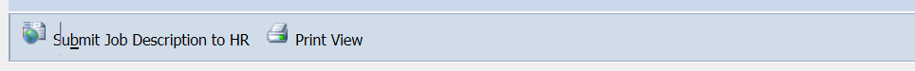
SUBMITTING A POSITION DESCRIPTION (cont’d)
Fill in all required fields
CLICK HERE TO SUBMIT YOUR FORM

Slide 6
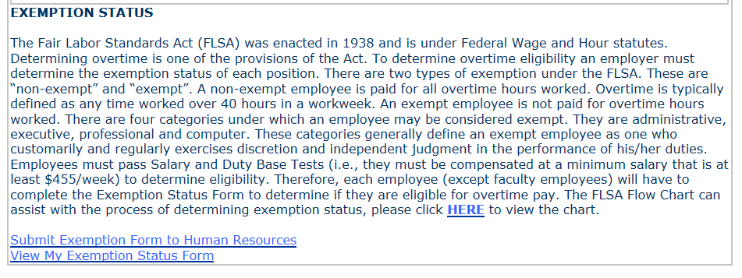
SUBMITTING AN EXEMPTION FORM
CLICK HERE

Slide 7
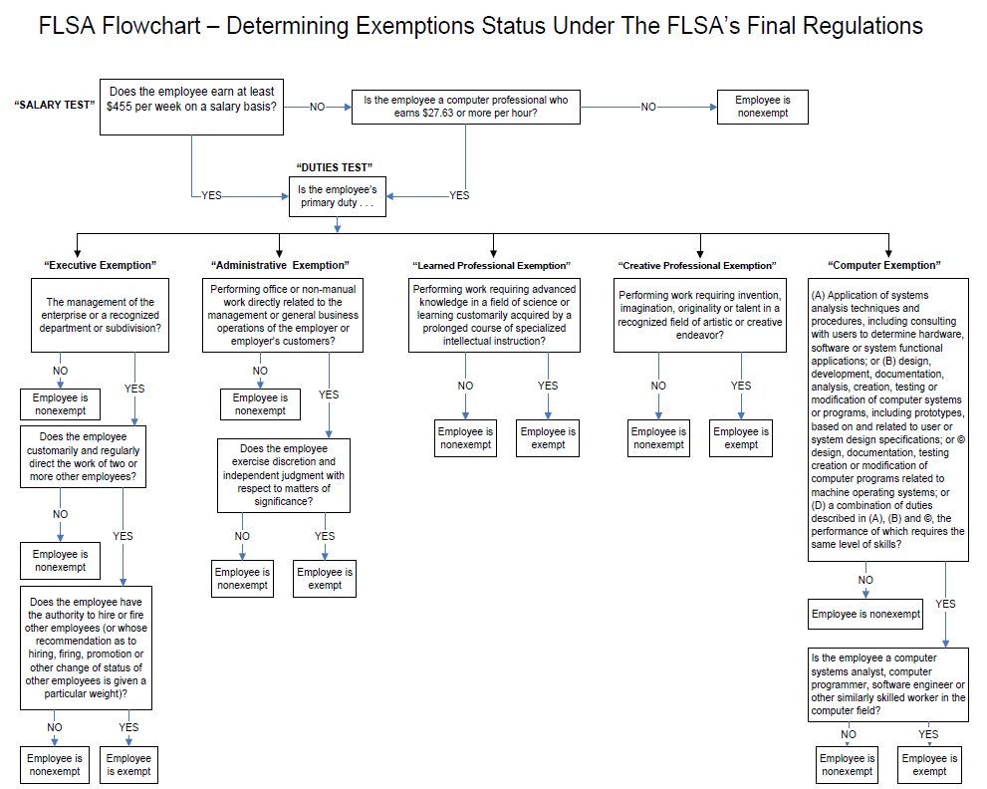
SUBMITTING AN EXEMPTION FORM
The FLSA Flowchart can assist with the process of determining your exemption status.

Slide 8
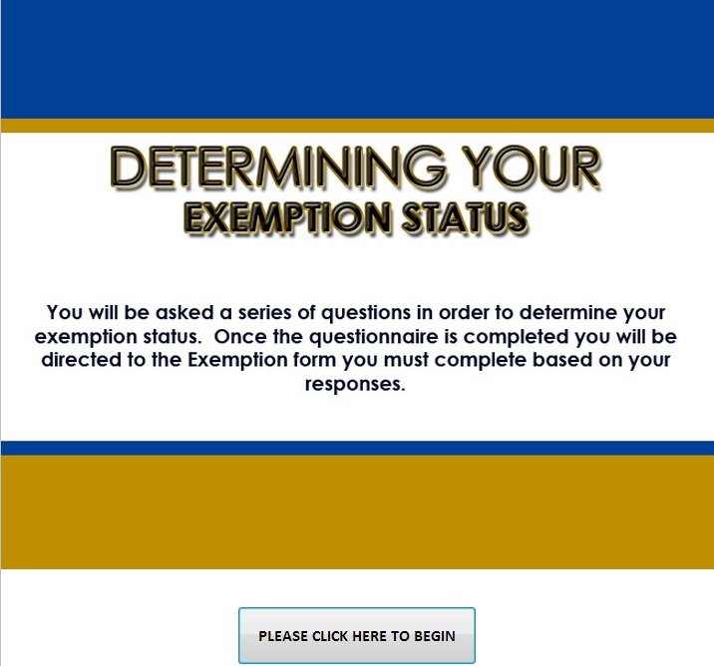
SUBMITTING AN EXEMPTION FORM (cont’d)
You will go through a brief questionnaire to determine which exemption status applies to you.
Based on your responses you will be directed to the form you must complete.

Slide 9
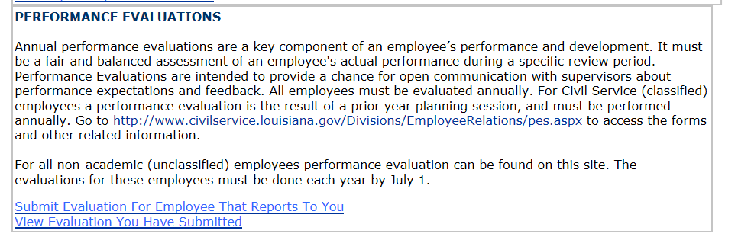
SUBMITTING AN EVALUATION
CLICK HERE

Slide 10
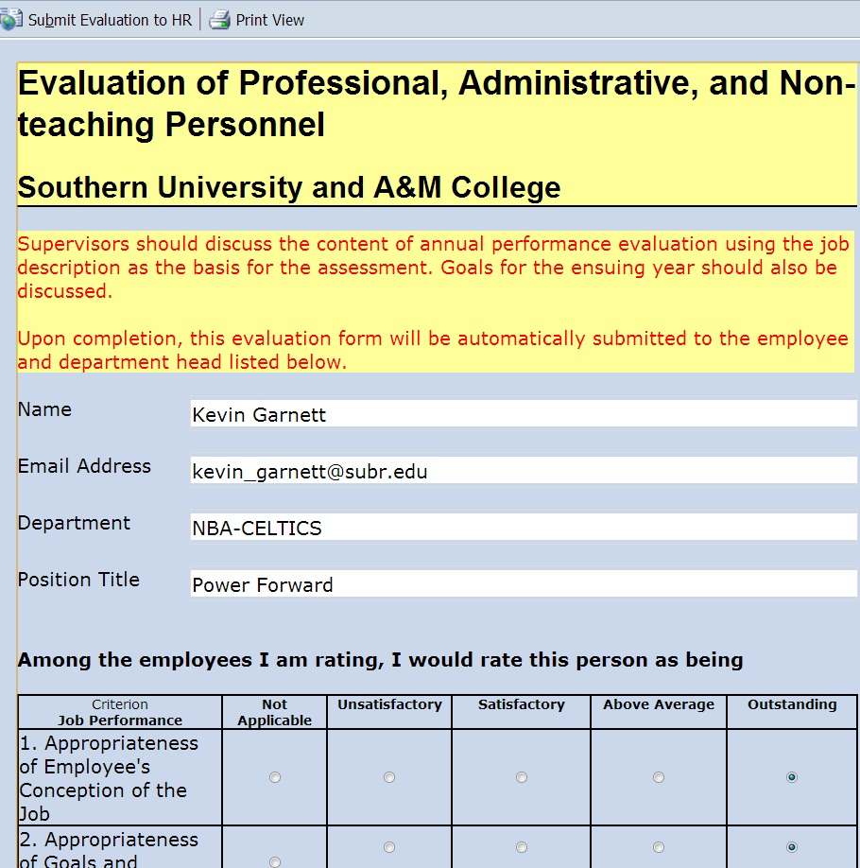
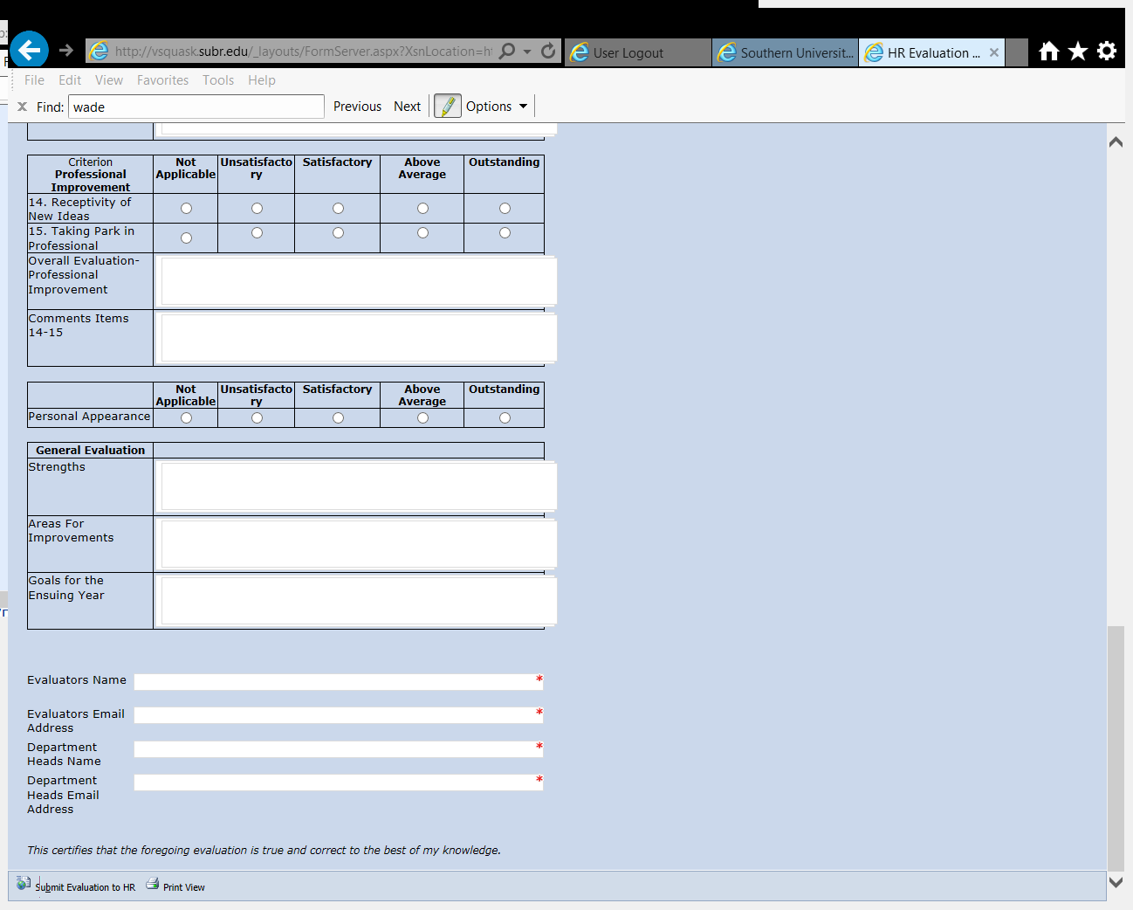
SUBMITTING AN EVALUATION (cont’d)
Click “Submit Evaluation to HR” upon completion.

Slide 11
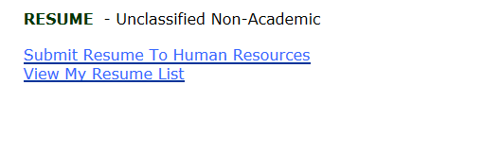
SUBMITTING A RESUME
CLICK HERE

Slide 12
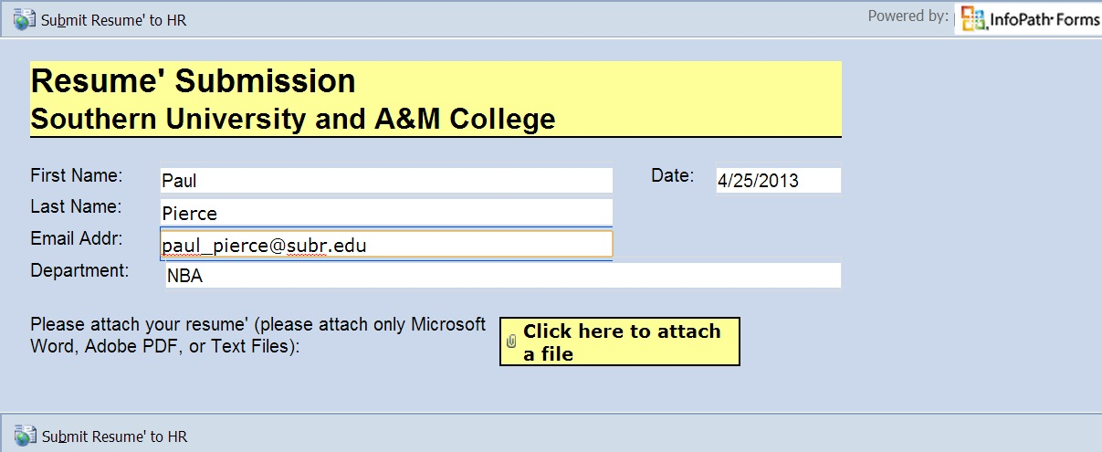
SUBMITTING A RESUME (cont’d)
CLICK HERE TO SUBMIT

Slide 13
If you need to reference this slide show please visit the Southern University System under the Human Resources Section and click on downloadable forms at: http://www.sus.edu/downloadable-forms
THE END

